Slide 1
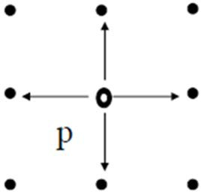
Neighborhood & Connectivity of Pixels

Slide 2

Motivation
Image Representation
173
175

Slide 3
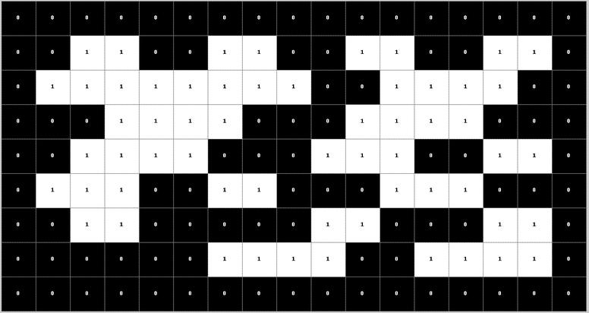



Motivation
Connected-component labeling
Input
Output: labeled image
Output: labeled image
Input

Slide 4

Motivation
Boundary tracing

Slide 5
Content
Topics to be covered
Neighborhood
Adjacency
Connectivity
Paths
Regions and boundaries

Slide 6
Neighbors of a Pixel
N₄ - 4-neighbors (2 Horizontal, 2 Vertical)
N_{D} - diagonal neighbors
N₈ - 8-neighbors (N₄ U N_{D})

Slide 7
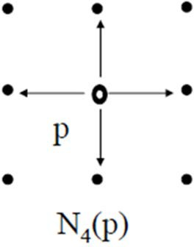



Neighbors of a Pixel
N₄(P) : 4-Neighbors of Pixel P are
2 vertical neighbors
2 horizontal neighbors
Coordinates of neighbors of P (x,y) are
(x+1, y), (x-1, y), (x, y+1), (x, y-1)
Distance from p
Each of the neighboring pixels in
N₄(P) are at a unit distance from P

Slide 8
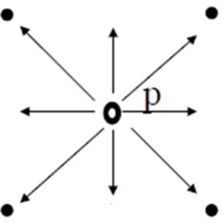

Neighbors of a Pixel
N_{D}(P): Diagonal Neighbors of Pixel P
The four diagonal neighbors of p(x, y) are given by
(x+1, y+1), (x+1, y-1), (x-1, y+1), (x-1 ,y-1)
This set is denoted by N_{D}(P)
Distance from P:
Each of neighboring pixels are at Euclidean distance of 1.414 from P
N_{D}(P): Diagonal Neighbors of Pixel P

Slide 9
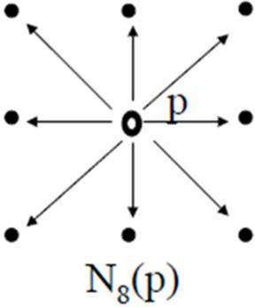
Neighbors of a Pixel
N₈(P) : 8-Neighbors of Pixel P are
– The points N_{D}(P) and N₄(P) are together (N_{D}(P) ∪ N₄(P) ) known as 8-neighbors of the point P
– It is denoted by N₈(P)
2 vertical neighbors
2 horizontal neighbors
4 diagonal neighbors
Boundary Case
– Some of the points in the N₄, N_{D} and N₈ may fall outside image when P lies on the border of image

Slide 10
Neighbors of a Pixel
N₄ - 4-neighbors (2 Horizontal, 2 Vertical)
N_{D} - diagonal neighbors
N₈ - 8-neighbors (N₄ U N_{D})
N_{D} | N₄ | N_{D}
N₄ | P | N₄
N_{D} | N₄ | N_{D}

Slide 11
Adjacency
Property
Two pixels are connected if they are neighbors, and
their gray levels satisfy some specified criterion of similarity
Example: in a binary image two pixels are connected
if they are 4-neighbors and
have same value (0/1)

Slide 12



Adjacency
Various types of adjacency
4-adjacency
8-adjacency
m-adjacency
To understand adjacency let us define V
Let V be set of gray levels used to define adjacency
V = {set of gray levels }

Slide 13
Adjacency
4-adjacency:
Two pixels p and q with values from V are 4-adjacent if q is in the set N₄(p)
8-adjacency:
Two pixels p and q with values from V are 8-adjacent if q is in the set N₈(p)
m-adjacency (mixed adjacency):
Two pixels p and q with values from V are m-adjacent if,
q is in N₄(p) or
q is in N_{D}(p) and the set [N₄(p) ∩ N₄(q)] is empty (has no pixels with values from V)

Slide 14

Adjacency
m-adjacency (mixed adjacency):
Two pixels p & q with values from V are m-adjacent if
q is in N₄(p) or
q is in N_{D}(p) and the set [N₄(p) ∩ N₄(q)] is empty (has no pixels whose values are from V) [yellow circles should not have anything common]
x: neighbor of p: N₄(p)
o: neighbor of q: N₄(q)
 |  |  | o
 |  | x, o | q | o
 | x | p | x, o
 |  | x
m-adjacency is modification of 8- adjacency.
It is used to remove the ambiguities of 8-adjacency.
This can be used to define single path between pixels.

Slide 15
Connectivity
𝑽 = {𝟏, 𝟐}
Assume:
– V be the set of gray-level values used to define connectivity
Two pixels p, q that have values from the set V are
4-connected, if q is in the set N₄(p)
8-connected, if q is in the set N₈(p)
m-connected, iff
q is in N4(p) or
q is in N_{D}(p) and the set N₄(p) ∩ N₄(q) is empty
0
1
1
(𝒂)
0
2
0
0
0
1
0
1
1
(b)
0
2
0
0
0
1
0
1
1
(𝒄)
0
2
0
0
0
1

Slide 16
Adjacency / Connectivity
0
1
1
0
1
0
0
0
1
8-adjacent
m-adjacent

Slide 17
Paths and Path Lengths
A path from pixel p with coordinates (x, y) to pixel q with coordinates (s, t) is a sequence of distinct pixels with coordinates:
(x₀, y₀), (x₁, y₁), (x₂, y₂) … (x_{n}, y_{n}),
where (x₀, y₀)=(x, y) and (x_{n}, y_{n})=(s, t)
(x_{i}, y_{i}) is adjacent to (x_{i-1}, y_{i-1}), 1≤n≤n
Here n is the length of the path
We can define 4-, 8-, and m-paths based on type of adjacency used

Slide 18
Connected Components
Connected pixels:
If p and q are pixels of an image subset S then p is connected to q in S if there is a path from p to q consisting entirely of pixels in S
Connected Component
For every pixel p in S, the set of pixels in S that are connected to p is called a connected component of S
Connected Set
If S has only one connected component then S is called Connected Set

Slide 19
Connected Components - Examples
Connected-component labeling
Input
Output: labeled image
Output: labeled image
Input

Slide 20
Region and Boundaries
Region of the image
A subset R of pixels in an image is called a Region of the image if R is a connected set
Each connected component forms a region
Boundary of the Region R
It is the set of pixels in the region that have one or more neighbors that are not in R
What if R happens to be entire Image?

Slide 21

Adjacency of Image Subsets
Pixel p is adjacent to pixel q if they are connected (neighbor)
Two image subsets S₁ and S₂ are adjacent if some pixel in S₁ is adjacent (neighbor) to some pixel in S₂
𝑺_{𝟏}
𝑺_{𝟐}
𝑺_{𝟏}
𝑺_{𝟐}

Slide 22
Arithmetic Logic Operation on Pixels
Addition : p + q
Subtraction: p – q
Multiplication: p*q
Division:
AND:
OR :
p/q
p AND q p OR q
Complement: NOT(q)

Slide 23
Neighborhood based Operations on Pixels
Value assigned to a pixel p₅ is a function of its neighboring pixels
 | p₁ | p₂ | p₃
 | p₄ | p₅ | p₆
 | p₇ | p₈ | p₉
w₁ | w₂ | w₃
w₄ | w₅ | w₆
w₇ | w₈ | w₉
p = w₁ p₁ + w₂ p₂ + w₃ p₃ + w₄ p₄ + w₅ p₅ + w₆ p₆ + w₇ p₇ + w₈ p₈ + w₉ p₉ = ∑ w_{i} p_{i} = 9
i=1
23 CS419/619: Computer Vision

Slide 24
Applications of Neighborhood Processing
Tasks done using neighborhood processing:
–Smoothing / averaging
–Noise removal / filtering
–Edge detection
–Contrast enhancement

Slide 25
Issues in Neighborhood Processing
Choice of w_{i}‘s
N² values
Window Size
Choice of N
Computation at boundaries
Do not compute at boundaries
Pad with zeros and extend image boundary
Pad assuming periodicity of image
Extrapolation of image

Slide 26
End

